Slide 1
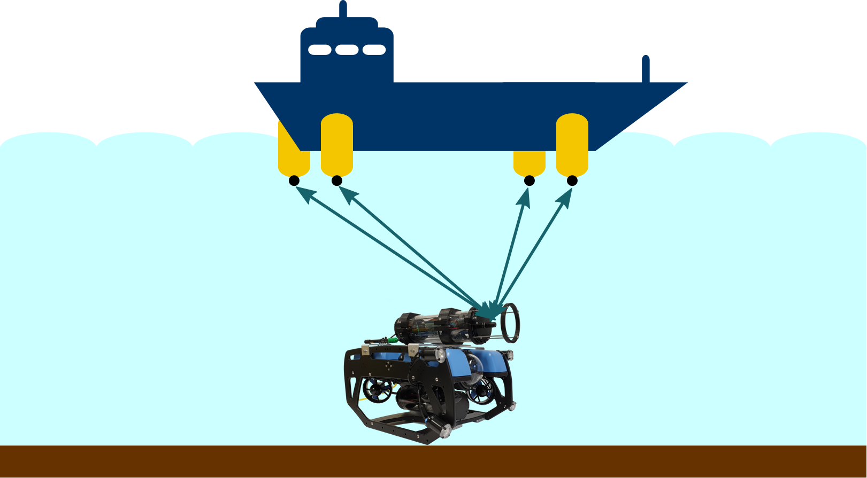
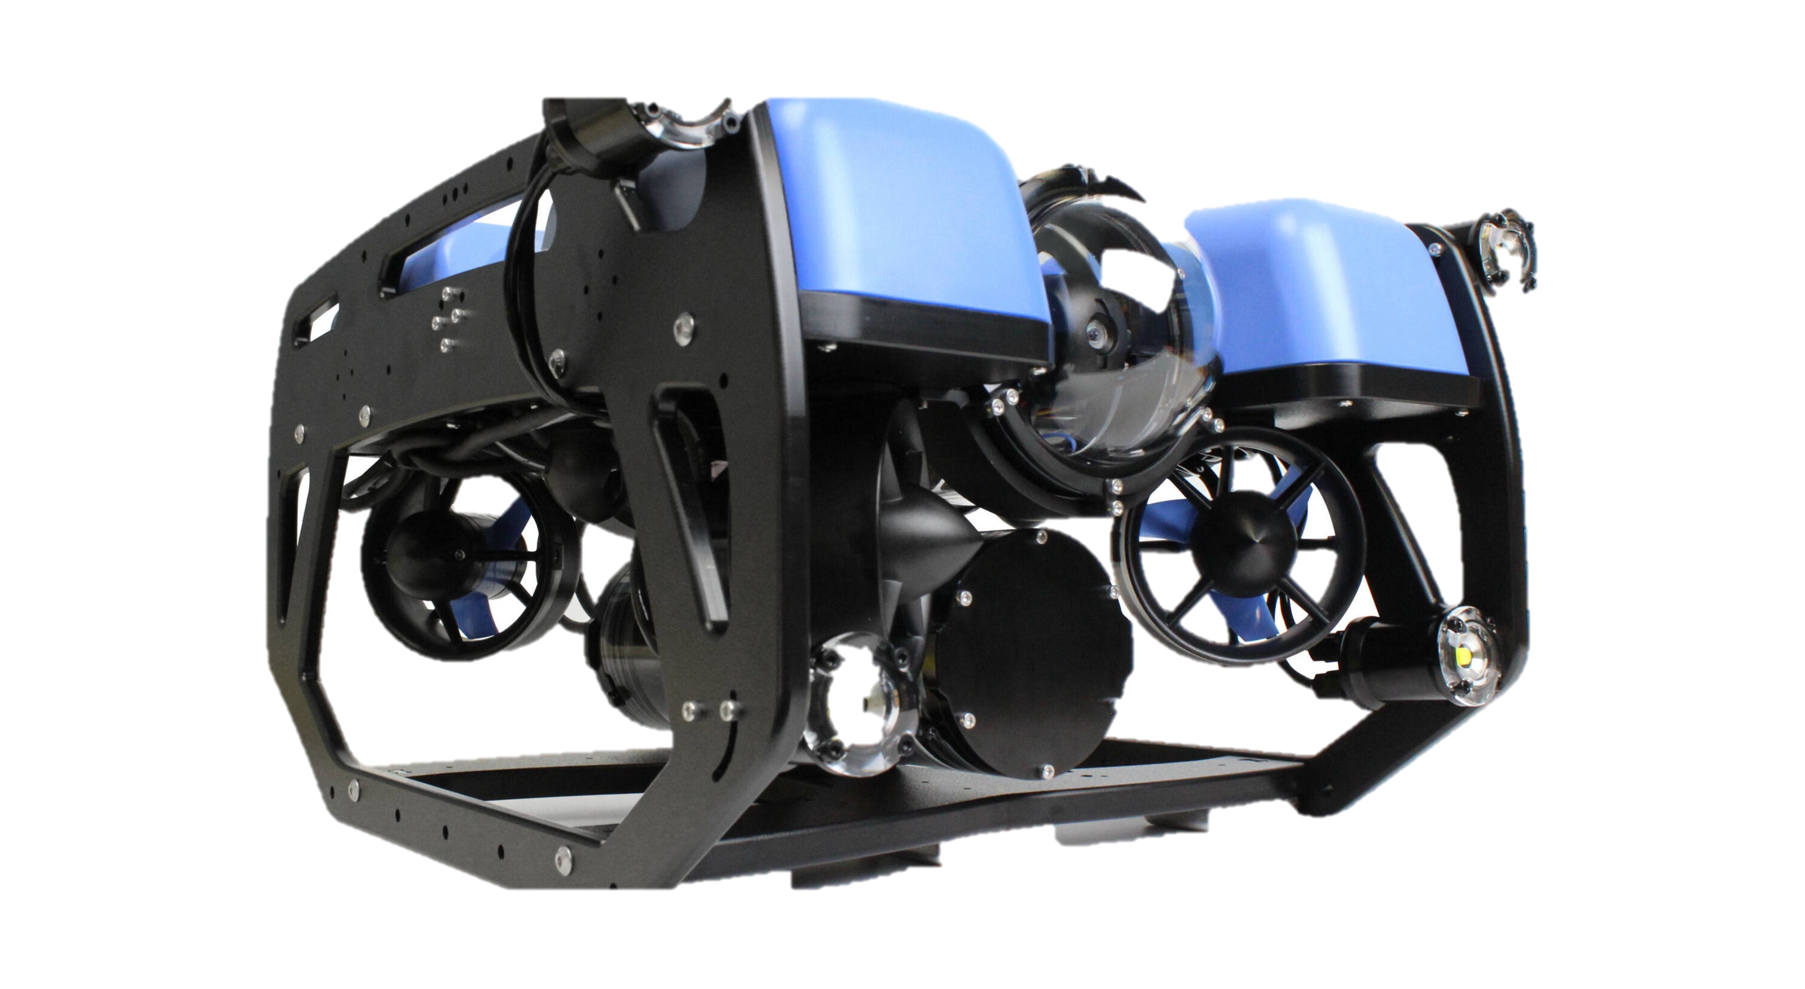
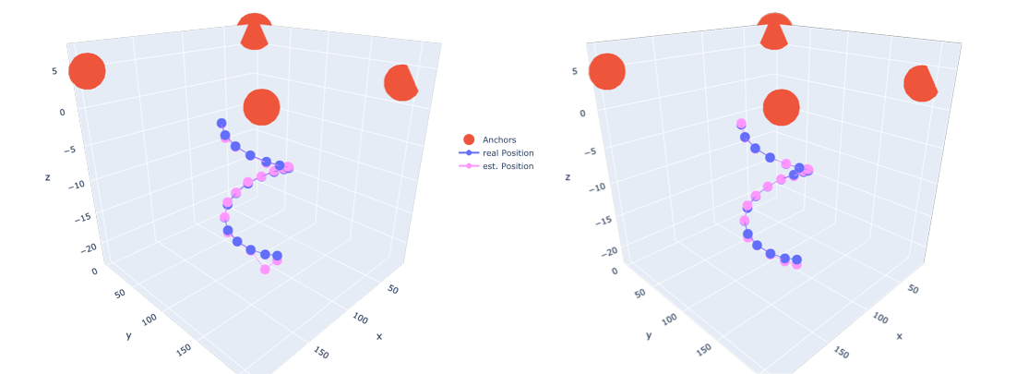
Orthogonal Codes for Acoustic Underwater Localization
Sergej Keller

Slide 2
Content
Motivation
Concept
Codes
Signal processing
Localization
Results
Conclusion
2

Slide 3
Motivation
Acoustic transmission
Underwater communication
Electromagnetic waves not applicable
Autonomous diving, underwater navigation
Self-localization
Reverse method of classic approach
anchors
distances
3

Slide 4



Concept
Acoustic signals from anchors
Send synchronized by hydrophones
Challenges like multipath propagation & noise
Time Difference of Arrival (TDOA)
Correlation technique to estimate position
Works great with orthogonal codes
Orthogonal PN codes
Separable signals
Already in use in telecommunications
anchor
$$τ_{1}$$
$$τ_{2}$$
$$τ_{3}$$
time
4

Slide 5
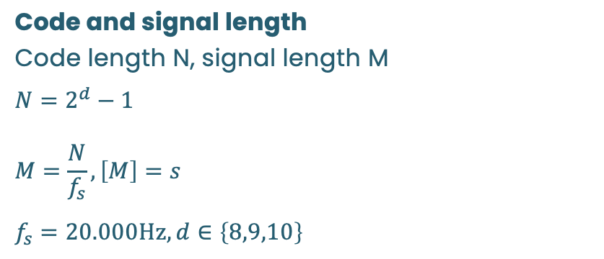
Orthogonal PN codes – overview
m-sequences
Kasami codes
Gold codes
Code properties
Auto-correlation properties → improved peaks in correlation
Cross-correlation → better separability, less cross talking
Code and signal length
Code length N, signal length M
$$N=2^{d}−1 \\ M=\frac{N}{f_{s}}, \left[M\right]=s$$
$$f_{s}=20.000\text{Hz}, d∈\left\{8,9,10\right\}$$
5

Slide 6
Orthogonal PN codes – evaluation results
Evaluation parameters
Peak to Sidelobe Ratio (PSR) → increases with peak clarity
Autocorrelation to Cross-correlation Ratio (ACR) → increases with code separability, orthogonality
Evaluation results
M-sequences have worst separability
Gold codes and Kasami codes are on the same level
Gold codes chosen because of larger sets → scalability of anchors
Gold codes
6

Slide 7
Signal processing – sending & receiving
Sending signal
Binary code converted to signed
up sampled & applied FIR filter
Shifted to transfer-band for transmission
receiving signal
Sum of signals filtered & back shifted to baseband
Second filter removing shifting characteristics
Cross correlation with original signals
7

Slide 8
Peak detection – CA-CFAR
Localization procedure
Cell Averaging – Constant False Alarm Rate
2 bins: guard and train
Guard cells increases threshold around peaks
train cells get an estimate of the sidelobes
Scaled by factor S, the resulting threshold decides between peak or false alarm
[Hermann Rohling. Ordered statistic cfar technique - an overview. In 2011 12th International Radar Symposium (IRS), page 635, 2011]
Alternative cell measure
Ordered Statistics – Constant False Alarm Rate
Using median instead of averaging
Not used in project
8

Slide 9


Localization
Localization algorithm
hyperbolic position location technique by TDOA
For N dimensions N+1 beacons needed
anchor
$$τ_{1}$$
$$τ_{2}$$
time
[Ralph Bucher and Durga Misra. A synthesizable vhdl model of the exact solution for three-dimensional hyperbolic positioning system. VLSI Design, 15, 2002]
9

Slide 10
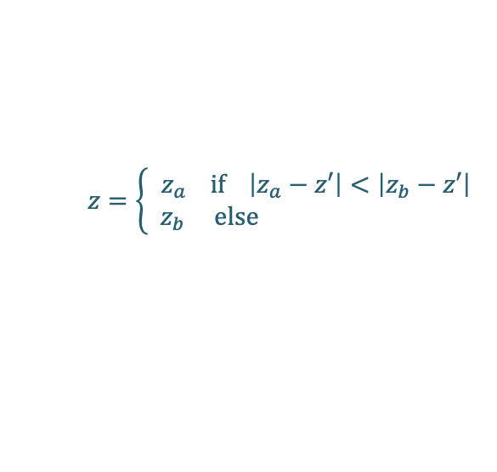
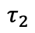
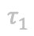
Localization
Localization algorithm
hyperbolic position location technique by TDOA
For N dimensions N+1 beacons needed
Used in GPS
Creates 2 candidates for position
Candidate selection
Environmental information
Conclusions based on previous position
anchors
$$τ_{1}$$
$$τ_{2}$$
candidates
$$z=\left\{\begin{aligned}z_{a} \text{if} \left|z_{a}−z′\right|<\left|z_{b}−z′\right| \\ { z}_{b} \text{else} \end{aligned}\right.$$
[Ralph Bucher and Durga Misra. A synthesizable vhdl model of the exact solution for three-dimensional hyperbolic positioning system. VLSI Design, 15, 2002]
10

Slide 11
Simulation
Simulation process
Delays, calculated from example coordinates, add to signals
Delayed signals get summed up
To the sum a by SNR adjustable noise gets added
Additional Watermark simulation
Uses different channels
Convolution by Dirac comb
H[s]
11

Slide 12
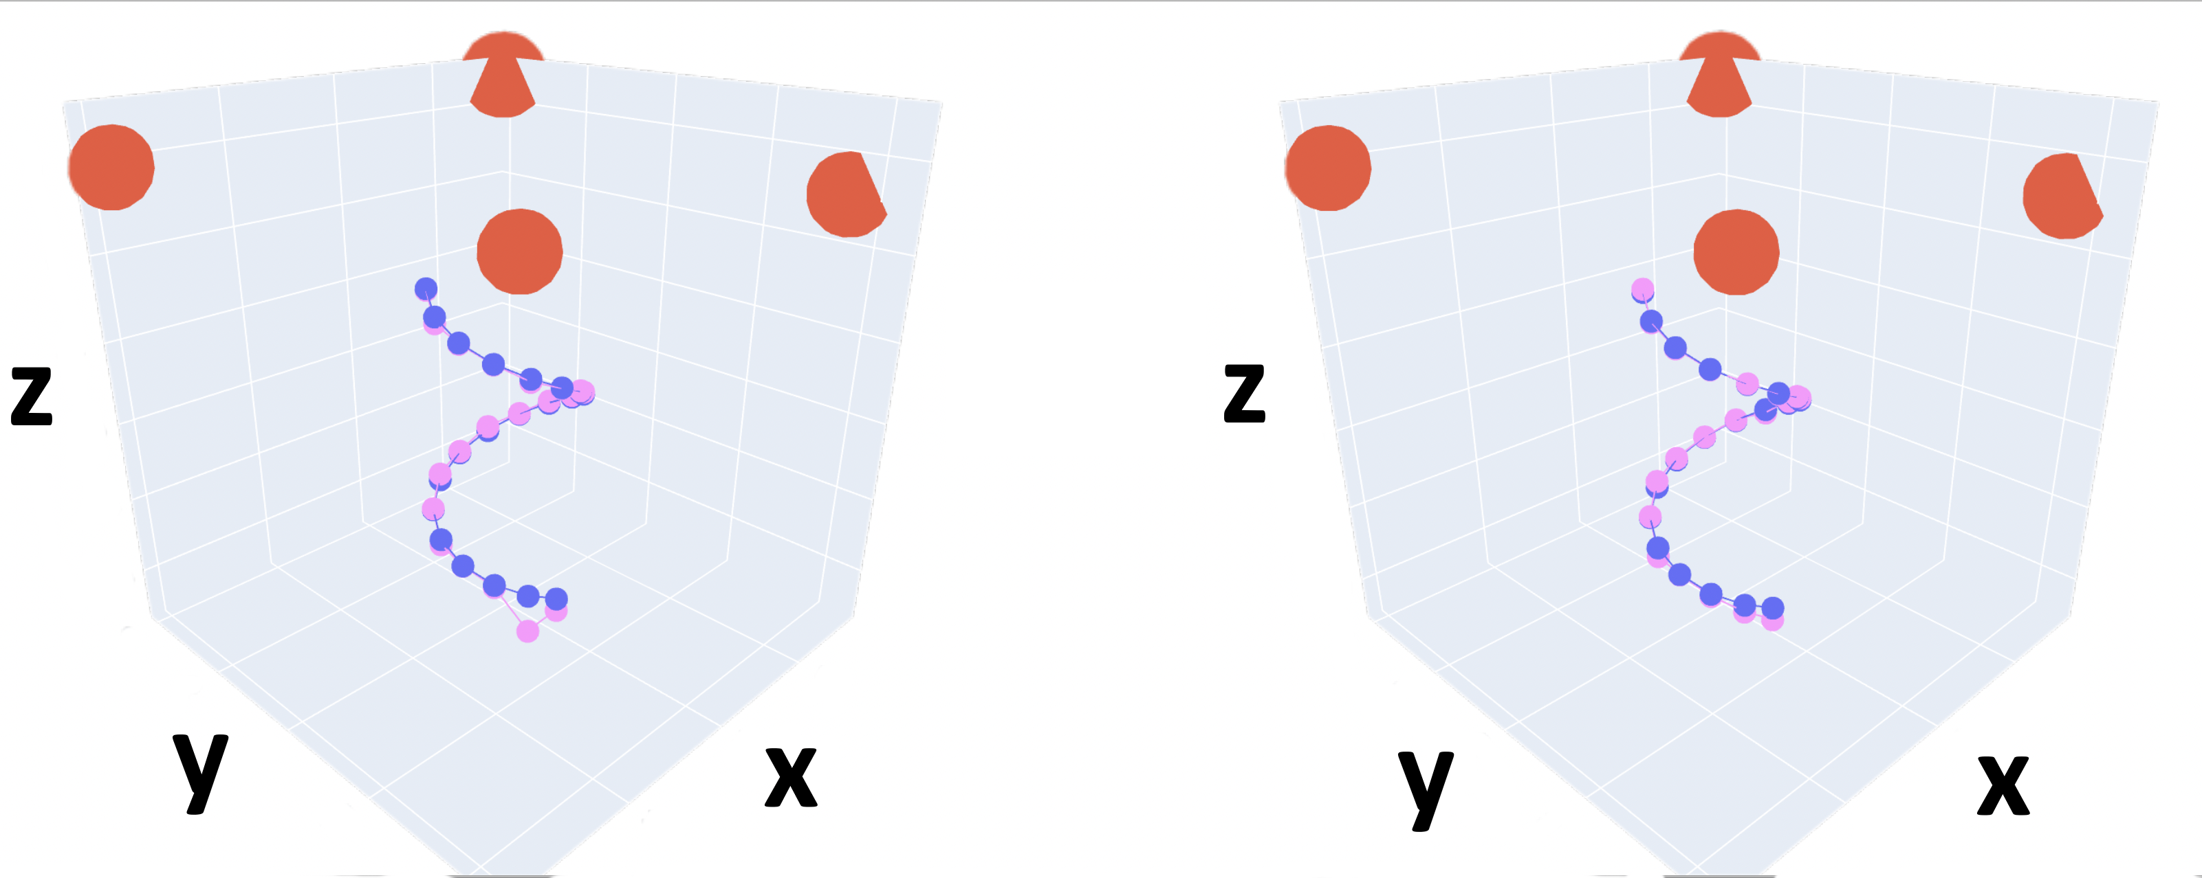
Simulation – results
For simulation, a circular path & corresponding TDOA are generated
4 anchors placed above spanning a rectangular shape
Different levels of noise and Watermark channels PLANE1 and CASTLE2 used
Increasing noise highly rise the risk of false detection of peaks and therefore unreliable position data
-5 dB
20 dB
12

Slide 13
Simulation – results
For simulation, a circular path & corresponding TDOA are generated
4 anchors placed above spanning a rectangular shape
Different levels of noise and Watermark channels PLANE1 and CASTLE2 used
Increasing noise highly rise the risk of false detection of peaks and therefore unreliable position data
[P. van Walree, R. Otnes, and T. Jenserud, Watermark: A realistic benchmark for underwater acoustic modems, in 2016 IEEE Third Underwater Communications and Networking Conference (UComms), Aug 2016]
CASTLE2, -5dB
PLANE1, -5dB
13

Slide 14
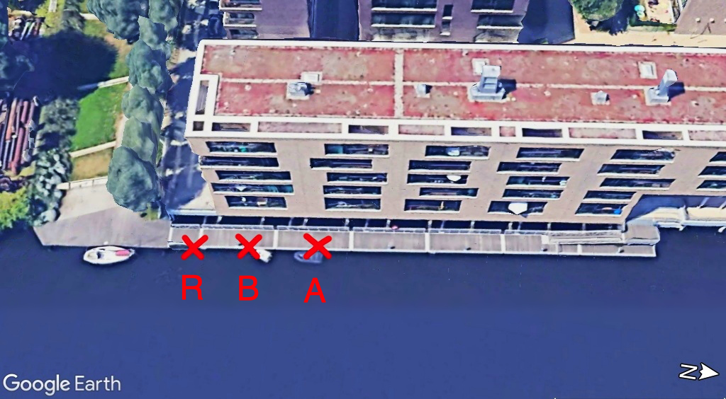
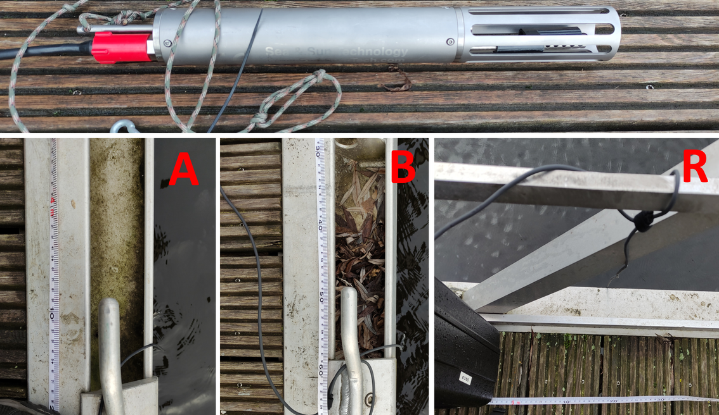
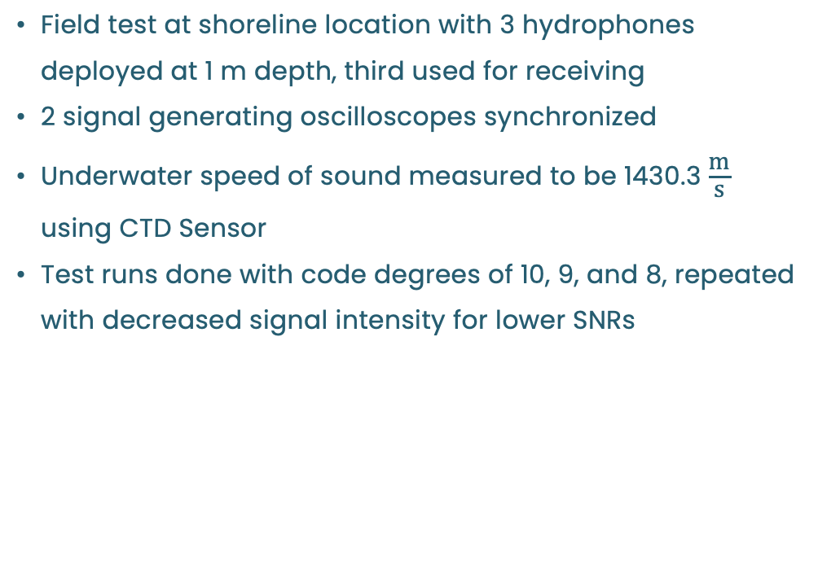
Real world setup
Field test at shoreline location with 3 hydrophones deployed at 1 m depth, third used for receiving
2 signal generating oscilloscopes synchronized
Underwater speed of sound measured to be 1430.3 $\frac{\text{m}}{\text{s}}$ using CTD Sensor
Test runs done with code degrees of 10, 9, and 8, repeated with decreased signal intensity for lower SNRs
anchor | distance to R | distance to R’
A | 4.1 m | 9.66 m
B | 10.74 m | 16.3 m
14

Slide 15
Real world setup - results
10th deg. code with high SNR
10th deg. code with low SNR
signals of 51ms vs 2.5ms length (10th vs 9th deg. code)
Values vary by 10cm
Decreased SNR shifts the position overall
Highest code degree most suitable
Algorithm yields satisfactory results
9th deg. code with high SNR
9th deg. code with low SNR
15

Slide 16
Conclusion
Project work results
Optimal orthogonal pseudorandom code gold codes selected for satisfactory properties
3D position localization algorithm developed & effectively simulated with 4 anchors
Code of 10th deg. yields usable results even with low SNR
Implementation in python
Objectives of improvement
CA-CFAR algorithm effective for peak detection but needs improvement
Room for improvement by alternative CFAR algorithm (OS-CFAR) & exploration of other peak detection methods
Future research of evaluating 3d position performance in real-world scenarios.
16

Slide 17
Literature and sources
Hermann Rohling. Ordered statistic cfar technique - an overview. In 2011 12th International Radar Symposium (IRS), page 635, 2011
Ralph Bucher and Durga Misra. A synthesizable vhdl model of the exact solution for three-dimensional hyperbolic positioning system. VLSI Design, 15, 2002
P. van Walree, R. Otnes, and T. Jenserud, Watermark: A realistic benchmark for underwater acoustic modems, in 2016 IEEE Third Underwater Communications and Networking Conference (UComms), Aug 2016
17

Slide 18
Thanks for your patience! Questions?

Slide 19
Simulation – results: -5dB and 20dB level noise

Slide 20
Simulation – results: -5dB and 20dB level noise + channels

Slide 21
Codes: evaluation

Slide 22
Simulation – results: relation between SNR and error

Slide 23
Simulation – results: relation between SNR and error (alt)

Slide 24
Bode plots of Butterworth (5th order)

Slide 25
Real world testing: degree of 8

